Slide 1

School of Electrical Engineering and Computer Science
Department of Electrical Engineering
EE-371 : Control Systems
Lecture#13,14
(Second Order System with Additional Pole)
(Second Order System with Additional Zeros)
Chapter #04
Text Book: Control Systems Engineering by Norman S. Nise 5th Edition
Instructor: Ms Neelma Naz
Class: BEE 12 C/D

Slide 2
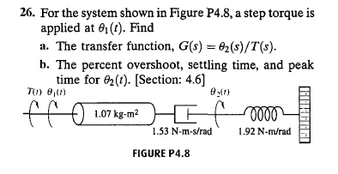
Class Activity

Slide 3
Second Order System with Additional Pole

Slide 4
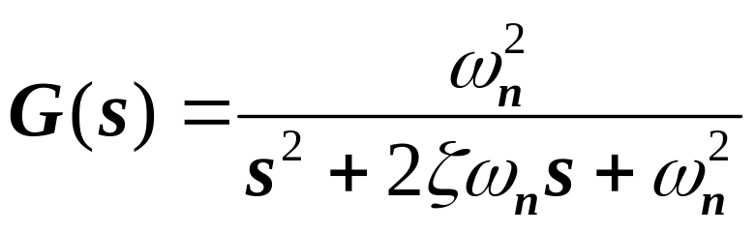
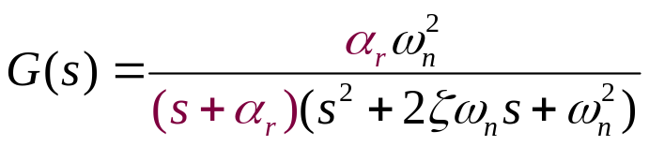
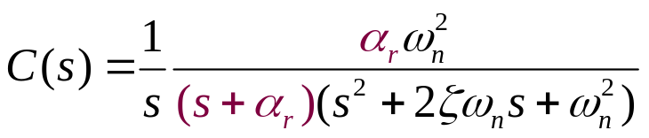
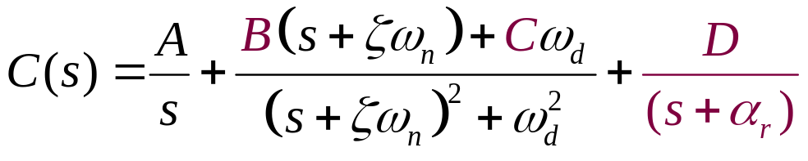
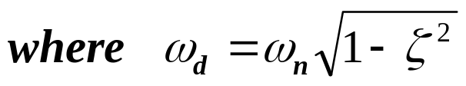
Second Order System with Additional Pole
Unity gain 2nd order system
Unity gain 2nd order system with additional pole at -α_{r}
Step response of 2nd order system with additional pole

Slide 5
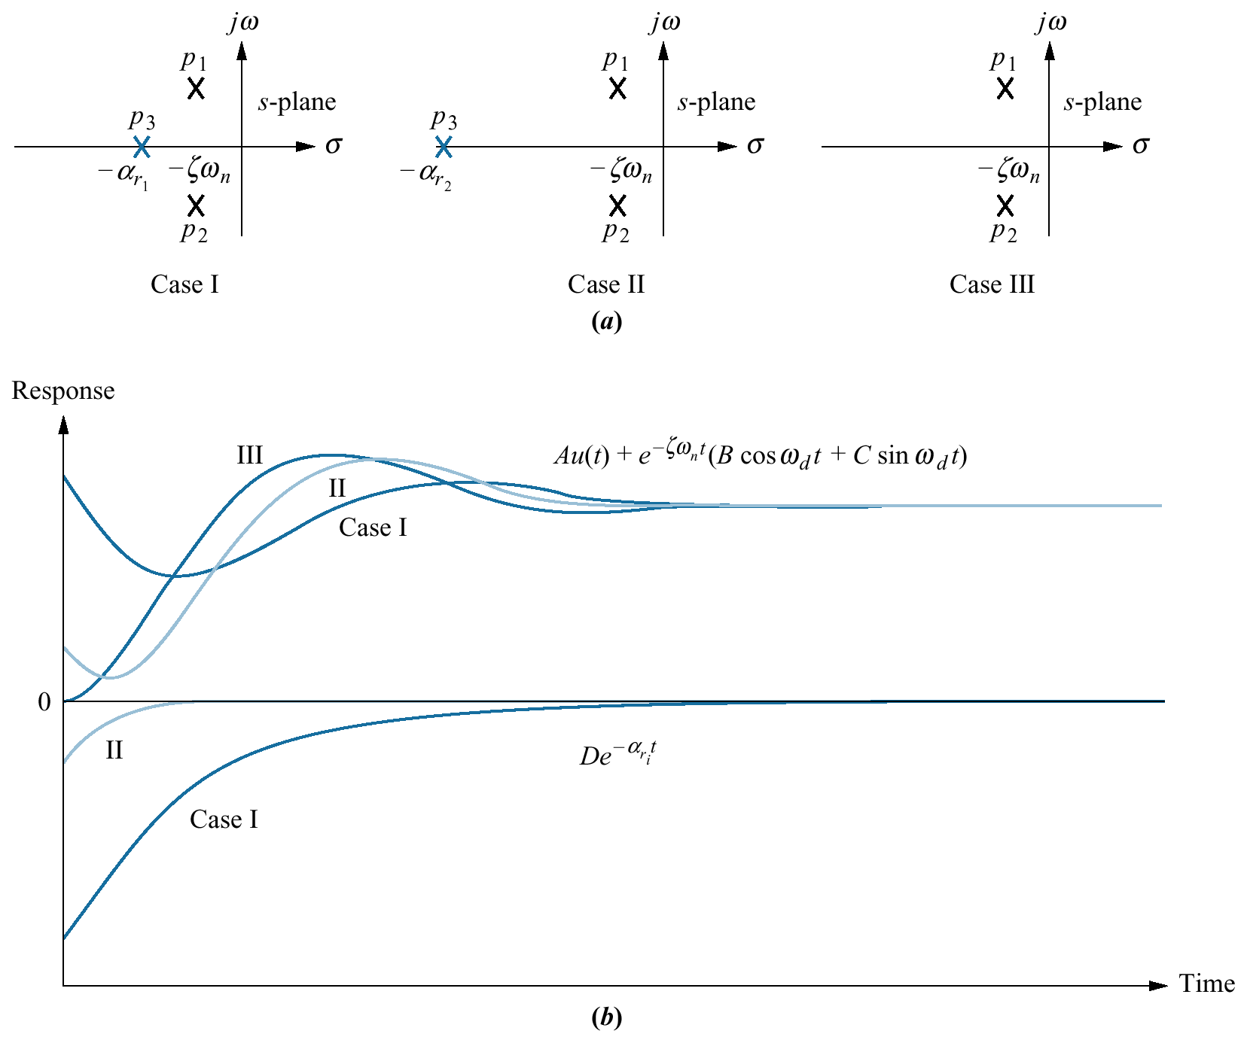
In time domain

Slide 7
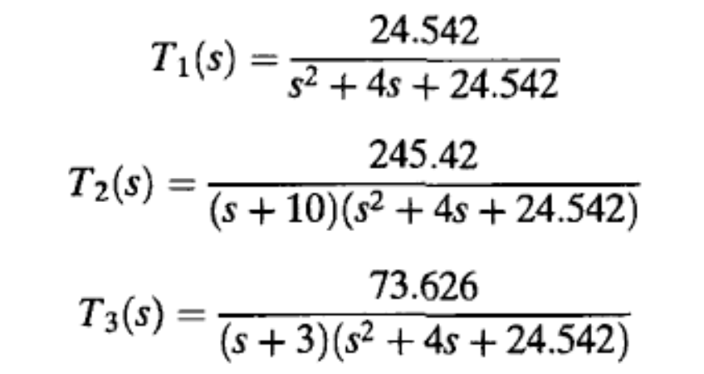

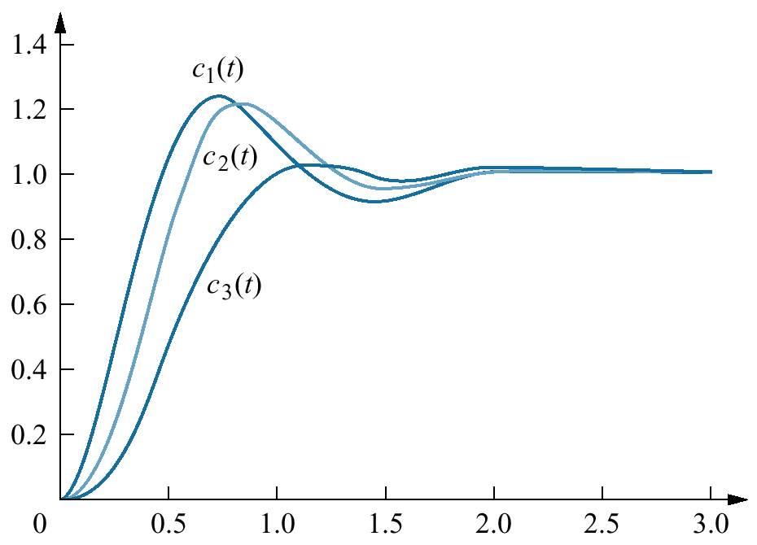
Example 4.8
(Comparing Responses of Three-Pole System)

Slide 8
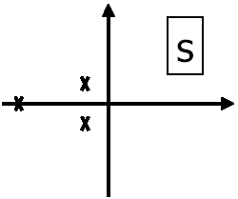
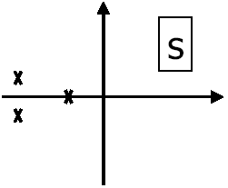
Complex poles dominant:
approximate as second order
system
Real pole dominant:
approximate as first-order system

Slide 9
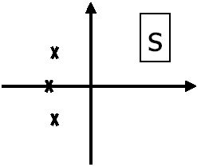
All three poles dominant:
approximation difficult

Slide 10
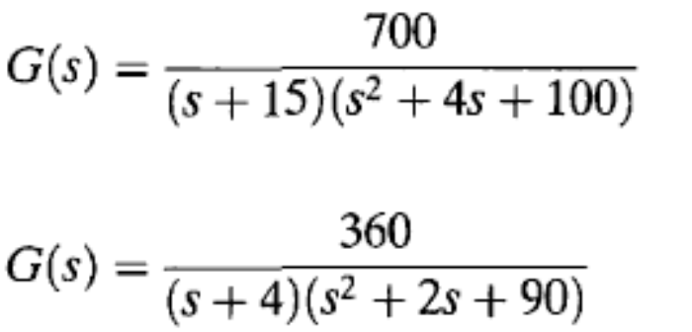
The “five times” rule of thumb can be used as necessary (but not sufficient) condition for second order approximation during design.
The completed design should be simulated before final implementation

Slide 11
Second Order System with Additional Zero

Slide 12
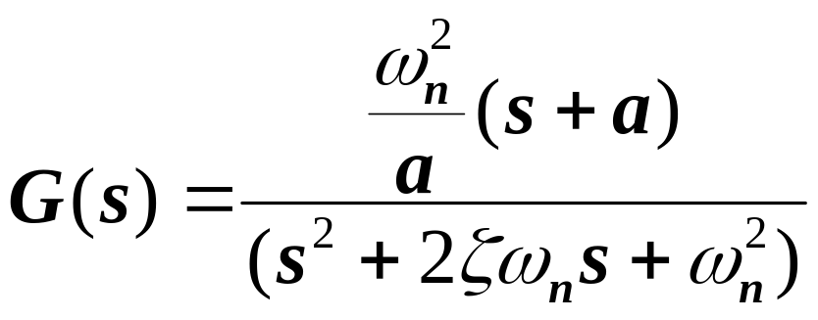
Second Order System with Additional Zero
Unity gain 2nd order system
Unity gain 2nd order system with zero at -a

Slide 13
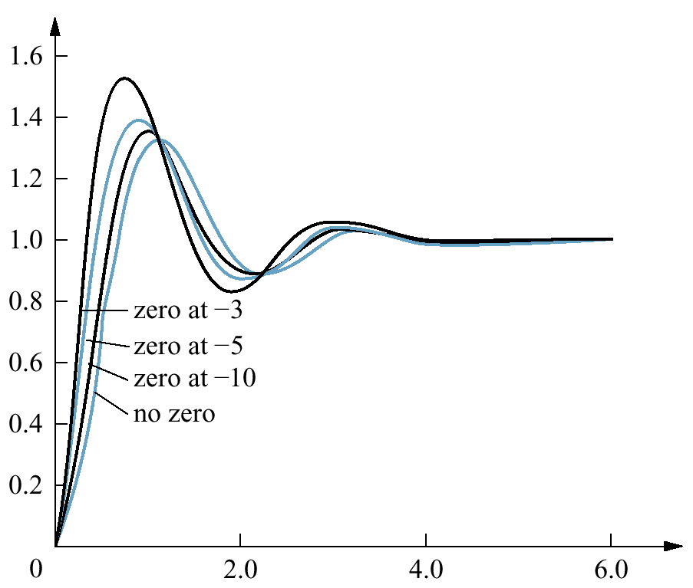
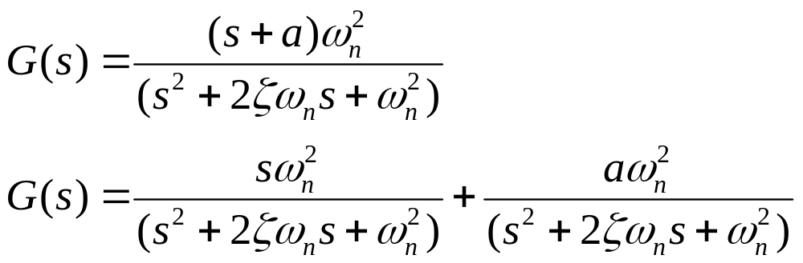
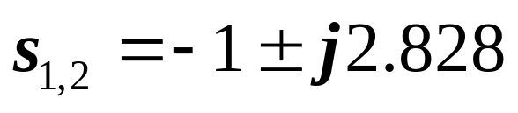
Adding a zero at -a
Scaled version of the response
Derivative of the response

Slide 14
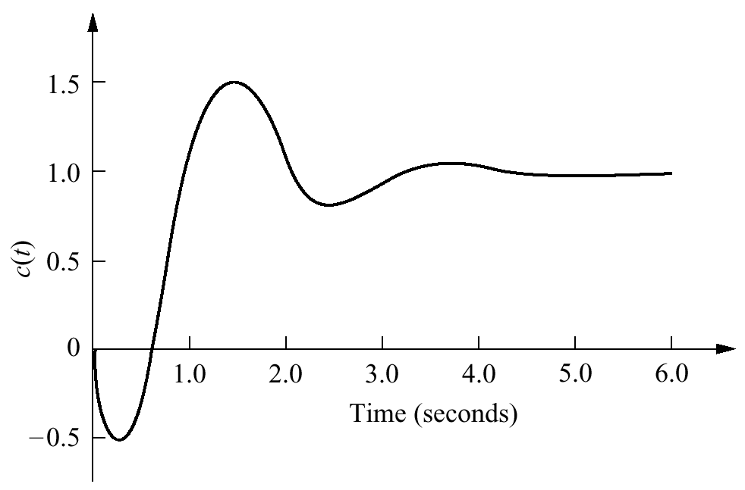
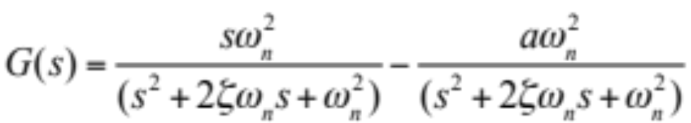
Step response with nonminimum-phase zero
Zero is in the right half of the s-plane
The response begins to turn toward the negative direction even though the final value is positive
A system that exhibits this phenomenon is known as a nonminimum-phase system

Slide 15
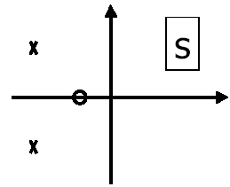
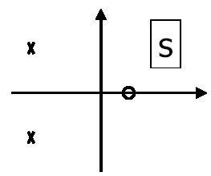
Lhp zero will amplify overshoot
Stable system, rhp zero can give response that starts in opposite direction from the steady-state resp

Slide 16
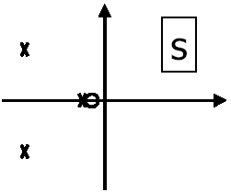
Complex conjugate poles
Dominant:
zero tends to minimize effect of nearby real pole

Slide 17
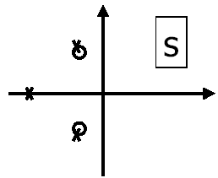
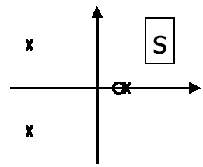
Real pole dominant,
zeros tend to minimize
effects of nearby poles
Unstable due to rhp pole,
nearby zero is not useful
in canceling pole

Slide 18
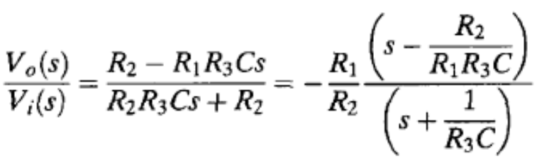
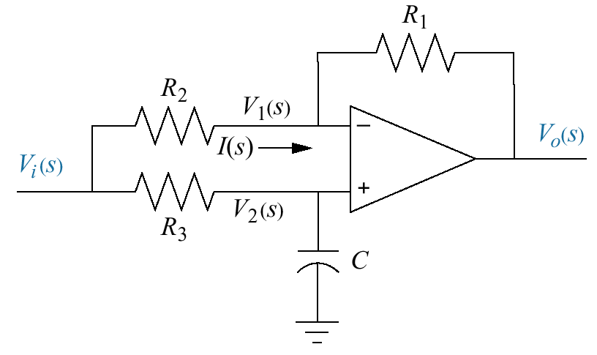
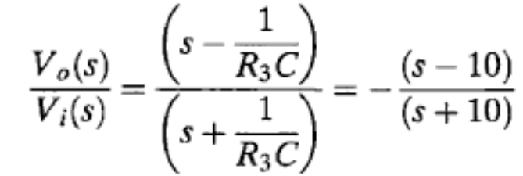
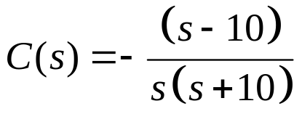
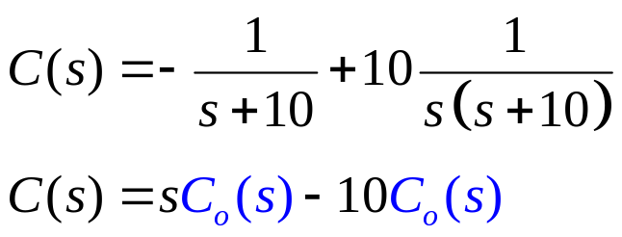
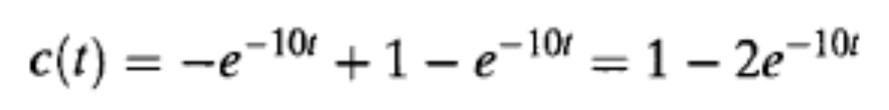
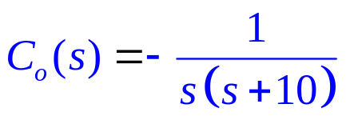
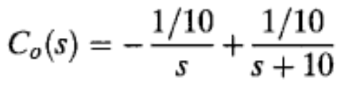
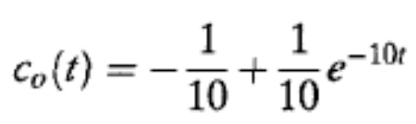
Example 4.9
Transfer Function of a Nonminimum-Phase System
Laplace transform of the response is:
Expanding C(s) into partial fractions
Expanding C_{o}(s) into partial fractions
C_{o}(s) is Laplace transform of the response without zero

Slide 19
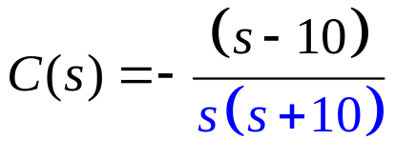
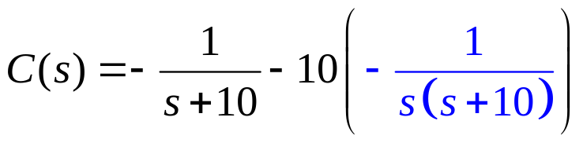
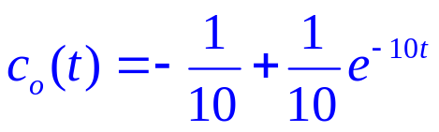
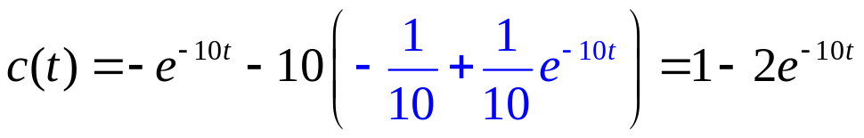
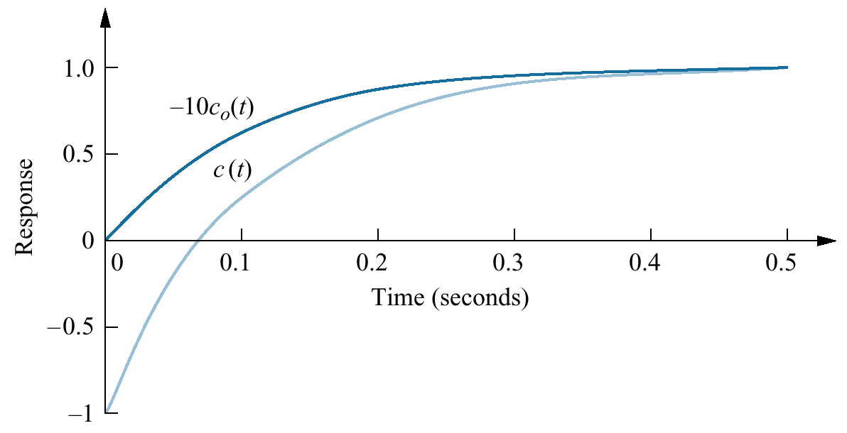

Slide 20
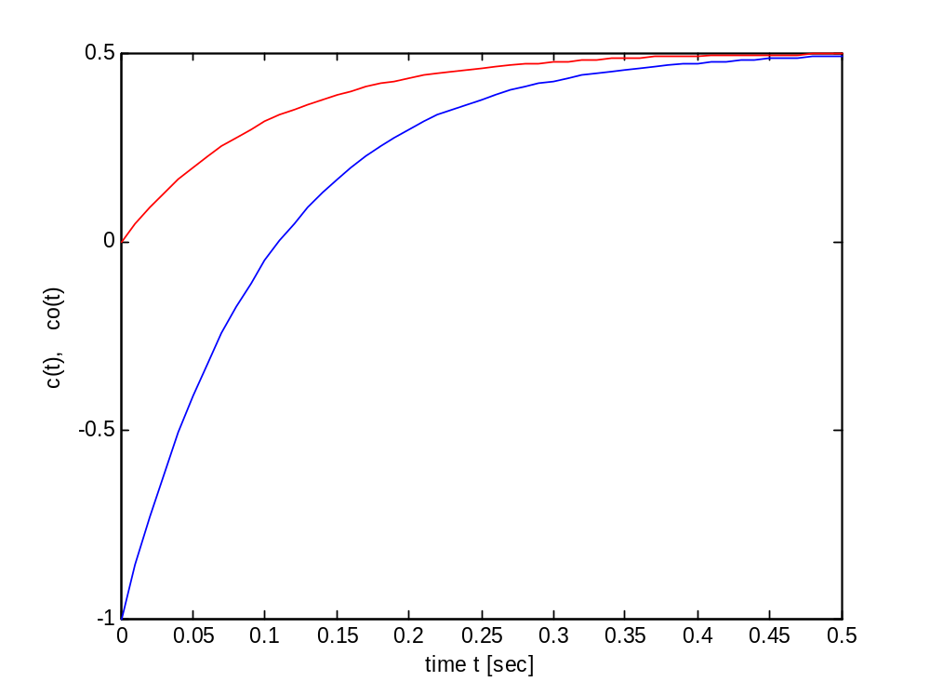
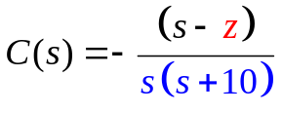
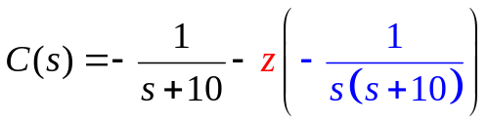
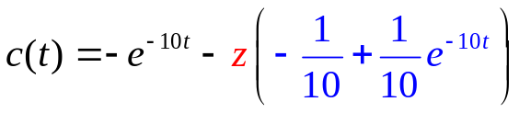
clc;
z=5; p=[-10]; k=-1;
[num,den]=zp2tf(z,p,k);
t=0:0.01:.5;
[c,x]=step(num,den,t);
zo=[]; po=[-10]; ko=-1;
[numo,deno]=zp2tf(zo,po,ko);
[co,xo]=step(numo,deno,t);
co=-z*co;
plot(t,c, 'b',t,co,'r');
xlabel('time t [sec]');
ylabel('(1):c(t), (2):co(t)');

Slide 21
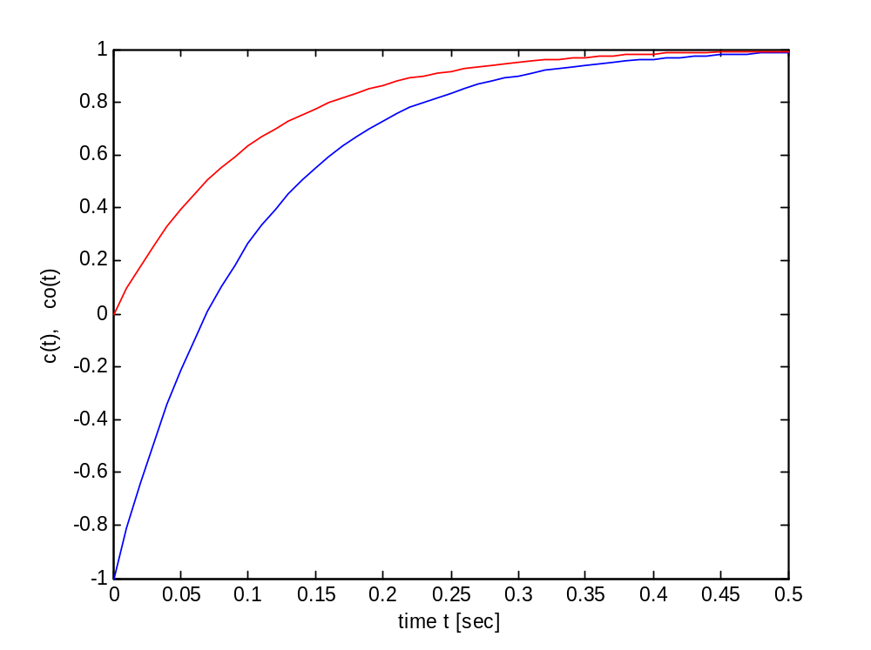
clc;
z=10; p=[-10]; k=-1;
[num,den]=zp2tf(z,p,k);
t=0:0.01:.5;
[c,x]=step(num,den,t);
zo=[]; po=[-10]; ko=-1;
[numo,deno]=zp2tf(zo,po,ko);
[co,xo]=step(numo,deno,t);
co=-z*co;
plot(t,c, 'b',t,co,'r');
xlabel('time t [sec]');
ylabel('(1):c(t), (2):co(t)');

Slide 22
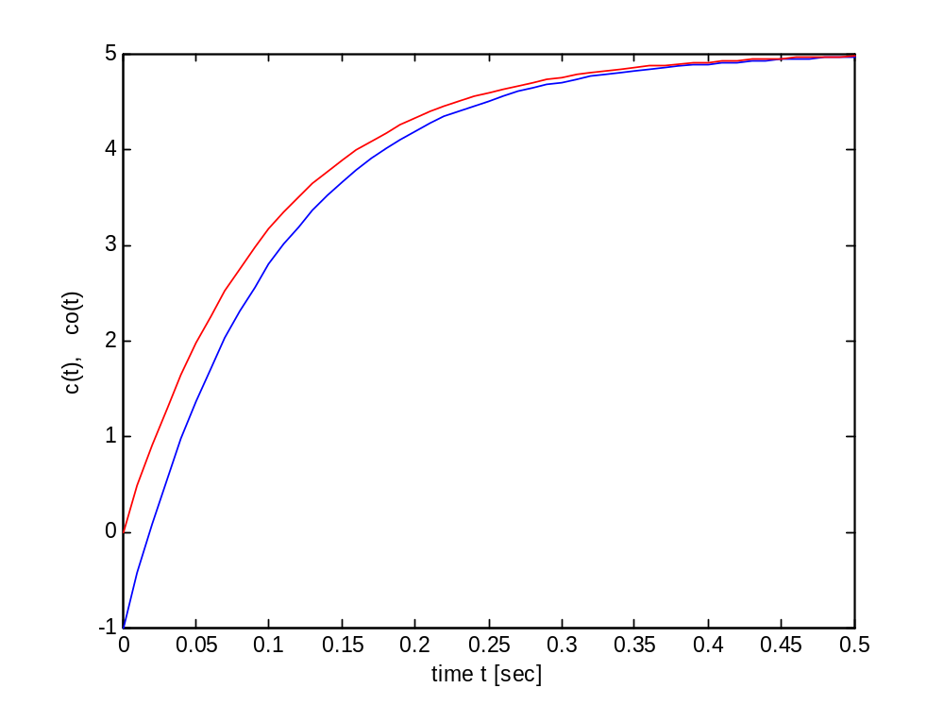
clc;
z=50; p=[-10]; k=-1;
[num,den]=zp2tf(z,p,k);
t=0:0.01:.5;
[c,x]=step(num,den,t);
zo=[]; po=[-10]; ko=-1;
[numo,deno]=zp2tf(zo,po,ko);
[co,xo]=step(numo,deno,t);
co=-z*co;
plot(t,c, 'b',t,co,'r');
xlabel('time t [sec]');
ylabel('(1):c(t), (2):co(t)');

Slide 23
z=10
z=50
z=5

Slide 24
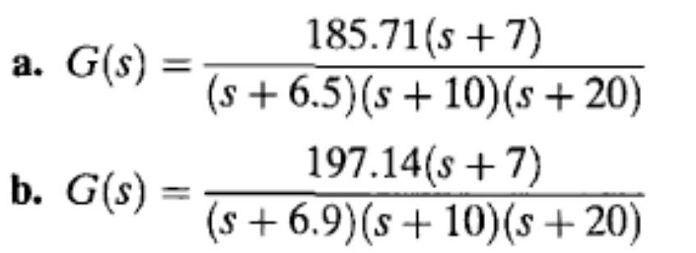
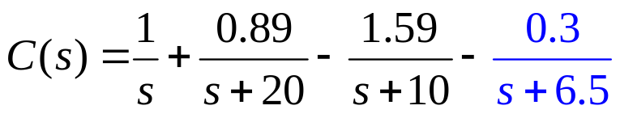
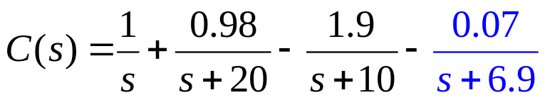
Skill-Assessment Exercise 4.7
PROBLEM: Determine the validity of a second-order step-response approximation for each transfer function shown below.
Laplace transform of step response is:
A second-order approximation is not valid.
Laplace transform of step response is:
A second-order approximation is valid.

Slide 25
Reduced Order Systems

Slide 26
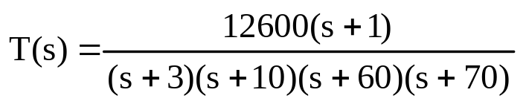
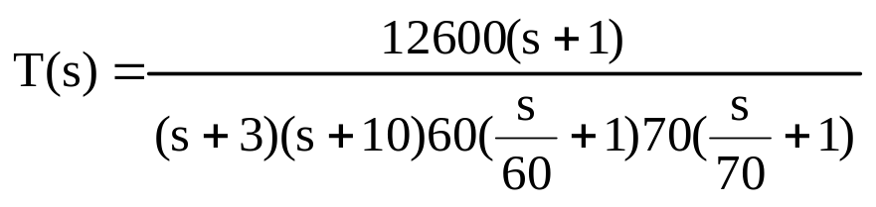
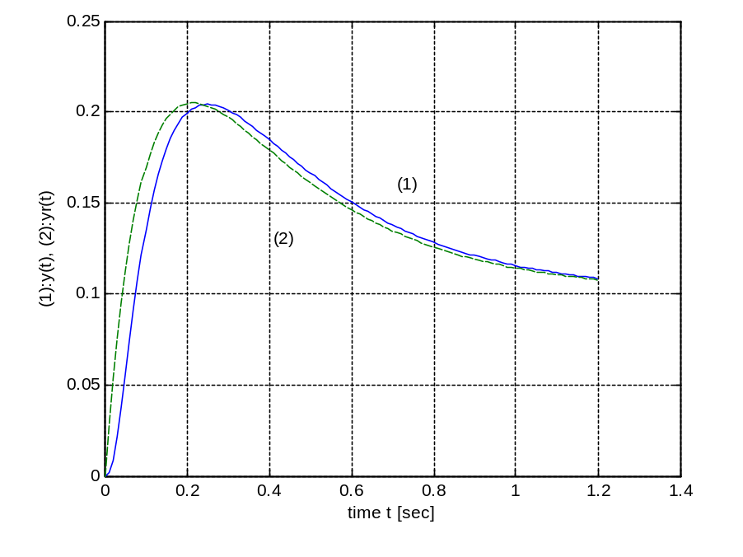

Reduced Order Systems
Example:
Since the poles at –60 and –70 are far to the left, their contribution to the system response is negligible (they decay very quickly to zero as e^{-60t} and e^{-70t})The transfer function can be formally simplified as follows:
z=-1; p=[-3 -10 -60 -70]; k=12600;
[num,den]=zp2tf(z,p,k);
t=0:0.01:1.2; [y,x]=step(num,den,t);
zr=-1; pr=[-3 -10]; kr=3;
[numr,denr]=zp2tf(zr,pr,kr);
[yr,xr]=step(numr,denr,t);
plot(t,y,t,yr,'--');
xlabel('time t [sec]');
ylabel('(1):y(t), (2):yr(t)');
grid; text(0.71,0.16,'(1)');
text(0.41,0.13,'(2)');
Use MATLAB to compare the step responses of the original and reduced-order systems.
It can be seen from this figure that step responses for the original and reduced-order (approximate) systems almost overlap.
Figure : System step responses for the
(1) original (____) and
(2) reduced-order approximate (------)

Slide 27



Case Study 01: Antenna Azimuth Position Control
We used the transfer functions to obtain the output response of an open-loop system. We observed the importance of the poles of a system in determining the transient response.
These concepts are used to analyze an open-loop portion of the antenna azimuth position control system comprising power amplifier and motor with load.

Slide 28

Figure 4.32
Antenna azimuth position control system for angular velocity: a. forward path; b. equivalent forward path
PROBLEM: For the schematic of the azimuth position control system, Configuration 1, assume an open-loop system (feedback path disconnected).
a. Predict, by inspection, the form of the open-loop angular velocity response of the load to a step-voltage input to the power amplifier.
b. Find the damping ratio and natural frequency of the open-loop system.
c. Derive the complete analytical expression for the open-loop angular velocity response of the load to a step-voltage input to the power amplifier, using transfer functions.

Slide 29
a. Predict, by inspection, the form of the open-loop angular velocity response of the load to a step-voltage input to the power amplifier.
b. Find the damping ratio and natural frequency of the open-loop system.

Slide 30

c. Derive the complete analytical expression for the open-loop angular velocity response of the load to a step-voltage input to the power amplifier, using transfer functions.

Slide 31


Figure 4.33
Unmanned Free-Swimming Submersible (UFSS) vehicle
Case Study 2.UM Free-Swimming Submersible Vehicle
Controlling the depth: During forward motion, an elevator surface on the vehicle is deflected by a selected amount. This deflection causes the vehicle to rotate about the pitch axis.
The pitch of the vehicle creates a vertical force that causes the vehicle to submerge or rise.
The pitch control system for the vehicle is used to
demonstrate the concepts.

Slide 32


Figure 4.34
Pitch control loop for the UFSS vehicle
PROBLEM: The transfer function relating pitch angle, θ(s), to elevator surface angle, δ_{e}(s), for the UFSS vehicle is

Slide 33

Figure 4.36
A ship at sea, showing roll axis

Slide 34
Reduction of Multiple Sub-Systems
Textbook: Chapter # 05 (5th edition)

Slide 35
Introduction
Subsystems represented by a block with its input and output.
We have learned how to find response of the subsystem.
Complicated systems are represented by the interconnection of subsystems.
We want to find response of the entire system. ?????
Represent the interconnected multiple subsystems as a single transfer function
Apply the analytical techniques, we lave learned for analyzing a subsystem, and obtain response information about the entire system.

Slide 36

Components of a block diagram for a linear, time-invariant system

Slide 37
Common Topologies for Interconnecting Subsystems

Slide 38

Cascade Form
Equivalent transfer function

Slide 39

Loading in cascaded systems

Slide 40

Parallel Form
Equivalent transfer function

Slide 41






Feedback Form
Equivalent transfer function
Simplified model

Slide 42
Block diagram algebra

Slide 43

Block diagram algebra for summing junctions
Equivalent forms for moving a block
a. To the left past a
summing junction
b. To the right past a
summing junction

Slide 44

Block diagram algebra for pickoff points
Equivalent forms for moving a block
a. To the left past a pickoff point
b. To the right past a pickoff point

Slide 45
Examples

Slide 46

Example 5.1
PROBLEM: Reduce the block diagram shown in the Figure to a single transfer function.

Slide 47

Example 5.1 (Solution)
a. collapse summing junctions
b. form equivalent cascaded system in the forward path and equivalent parallel system in the feedback path
c. form equivalent feedback system and multiply by cascaded
G₁(s)

Slide 48


Example 5.2
PROBLEM: Reduce the system shown in the Figure to a single transfer function.

Slide 49
Example 5.2
(Solution)

Slide 50
Example 5.2
(Solution)

Slide 51
Home Assignment
Exercise 5.1
Problems: 1, 2, 3, 4, 5, 6
-------------------------------------
Exercise 5.1 & Problems: 1,4 Do submit

Slide 52

???

